Slide 1
`
ONLINE MOVIE TICKET BOOKING SYSTEM

Slide 2
`
1.Problem Definition:
The problem definition for a Content Management System (CMS) typically addresses the challenges faced by individuals or organizations in managing digital content. A CMS aims to solve issues such as:
Content Creation: Simplifying the process of creating content without needing technical expertise.
Content Storage: Organizing content in a way that is secure, scalable, and easily retrievable.
Content Publishing: Streamlining the process of making content live on a website with minimal steps.
Content Modification: Allowing for easy updates and edits to content, often with version control.
User Access Control: Managing permissions for different users to access certain content or features within the CMS.
Content Distribution: Ensuring content can be delivered across various channels and devices efficientl

Slide 3
`
2 Need of Project:
The need for a CMS project arises from the necessity to efficiently manage and deliver
content. Here are some key reasons why a CMS project is essential:
Streamlined Content Management: A CMS allows for easy content creation, editing, and deletion, making it simpler for non-technical users to maintain website content.
Collaboration: Multiple users can work on content simultaneously, with various permission levels to control access and editing rights.
Consistency: Ensures a consistent appearance for all the content across the website, which is crucial for brand identity and user experience.
SEO Optimization: Agood CMS will support SEO best practices to help improve the visibility of the website in search engine results.
Cost-Effectiveness: Reduces the need for expensive technical resources for everyday content updates and site maintenance.
Scalability: Can grow with the business, accommodating more content and more complex functionalities as needed.
Regulatory Compliance: Helps in adhering to data protection and privacy laws by managing how content is stored and displayed

Slide 4
`
3 .Requirement
Server-Side Requirements:
Hardware Requirements:
Processor: Multi-core processor (e.g., Intel Core i5 or better)
RAM: Minimum 2GB (4GB+ recommended for better performance)
Storage: SSD storage recommended for faster read/write operations
Network: Stable internet connection with sufficient bandwidth for expected user traffic
Software Requirements:
Operating System: Linux (e.g., Ubuntu, CentOS), Windows Server
Web Server: Apache, Nginx
Database: MySQL, PostgreSQL, MongoDB (depending on CMS requirements)
Programming Language: PHP, Python, Node.js (based
on CMS platform)
CMS Platform: WordPress, Joomla, Drupal, etc.
Security: SSL certificate for HTTPS, firewall configurations
Additional Tools: Content delivery network (CDN) for optimized content delivery
Client-Side Requirements:
Hardware Requirements:
1. Device: Desktop, laptop, tablet, or smartphone

Slide 5
`
Processor: Modern processor for smooth rendering and interaction
RAM: Typically 2GB or more for better multitasking
Software Requirements:
Operating System: Windows, macOS, Linux, iOS, Android
Web Browser: Latest versions of Chrome, Firefox, Safari, Edge, or compatible browsers
Browser Plugins: JavaScript enabled, cookies enabled (as required by the CMS)
Internet Connection: Stable broadband or cellular connection
Additional Considerations:
Scalability: Ensure the server infrastructure can scale with increased traffic and content.
Backup and Recovery: Implement regular backups of
CMS data and configurations.
Monitoring and Maintenance: Use monitoring tools for server health and CMS performanceA.
Accessibility: Ensure the CMS interface is accessible
across different devices and screen sizes.
Web Server: Apache, Nginx
Database: MySQL, PostgreSQL, MongoDB (depending on CMS requirements)
Programming Language: PHP, Python, Node.js (based on CMS platform)
CMS Platform: WordPress, Joomla, Drupal, etc.
Security: SSL certificate for HTTPS, firewall configurations
Additional Tools: Content delivery network (CDN) for optimized content delivery
Client-Side Requirements:
Hardware Requirements:
Device: Desktop, laptop, tablet, or smartphone
Processor: Modern processor for smooth rendering and interaction
RAM: Typically 2GB or more for better multitasking

Slide 6
`
Software Requirements:
Operating System: Windows, macOS, Linux, iOS, Android
Web Browser: Latest versions of Chrome, Firefox, Safari, Edge, or compatible browsers
Browser Plugins: JavaScript enabled, cookies enabled (as required by the CMS)
Internet Connection: Stable broadband or cellular connection
Additional Considerations:
Scalability: Ensure the server infrastructure can scale with increased traffic and content.
Backup and Recovery: Implement regular backups of CMS data and configurations.
Monitoring and Maintenance: Use monitoring tools for server health and CMS performanceA.
Accessibility: Ensure the CMS interface is accessible across different devices and screen sizes.
9. Technology Used
Technology used:
Font End: HTML5, CSS3, JS, Bootstrap, jQuery
Back End: PHP, MY SQL.

Slide 7
`
4 Functional and Non- Functional Dependency:
Functional Dependencies:
Content Operations: The ability to create, read, update, and delete content.
User Management: Managing user roles and access permissions.
Content Workflow: A system for reviewing, approving, and publishing content.
Template Management: Handling the design templates for content presentation.
Media Management: Uploading and managing media files like images and videos.
Search Functionality: Enabling users to search for content within the CMS.
Version Control: Tracking changes to content over time.
Non-Functional Dependencies:
Performance: The CMS should load content quickly and handle traffic efficiently.
Scalability: It should be able to scale with the growth of content and users.
Security: Protecting against unauthorized access and data breaches.
Usability: The interface should be user-friendly and intuitive.
Compatibility: Working well across different browsers and devices.
Maintainability: The system should be easy to maintain and update.
Compliance: Adhering to relevant legal and regulatory standards.

Slide 8
`
5 Introduction:
HTML (Hypertext Markup Language) is the standard markup language used to create web pages. It provides the structure of a webpage, allowing you to define elements like headings, paragraphs, links, and images.
CSS (Cascading Style Sheets) is used to style and layout web pages. It lets you apply styles to HTML elements, such as colors, fonts, and spacing, and control the layout of multiple web pages with a single stylesheet.
JavaScript (JS) is a scripting language that enables you to create dynamically updating content, control multimedia, animate images, and much more. It’s an essential part of web applications and enhances user interaction.
jQuery is a fast, small, and feature-rich JavaScript library designed to simplify the client-side scripting of HTML. It was found in January 2006.
PHP (Hypertext Preprocessor) is a server-side scripting language designed for web development. It’s used to manage dynamic content, databases, session tracking, and even build entire e-commerce sites.
MySQL is a relational database management system based on SQL (Structured Query Language). It’s used to store, retrieve, and manage data in a database. It’s commonly used in conjunction with PHP to create dynamic web applications.

Slide 9
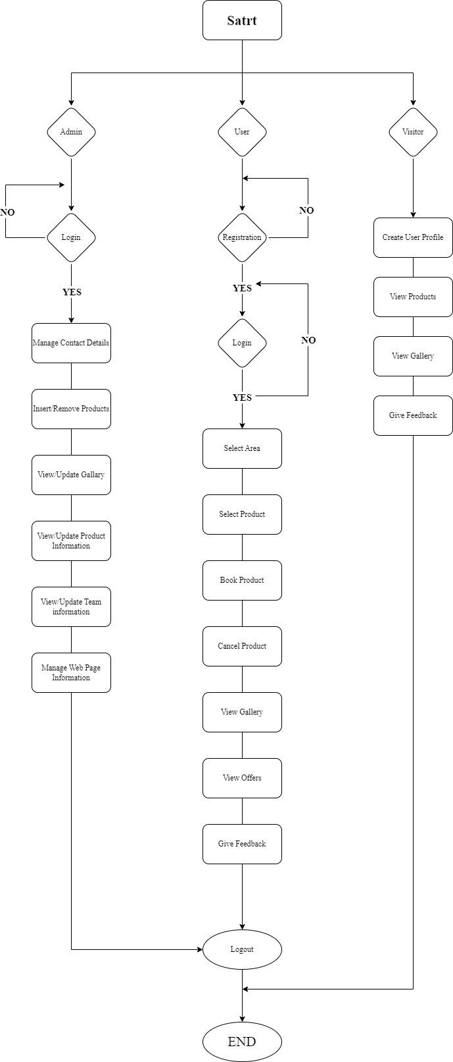
`
Design:
System Flow Diagram

Slide 10
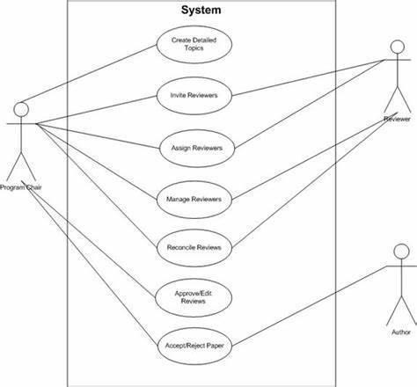
`
6.2 USE CASE Diagram

Slide 11
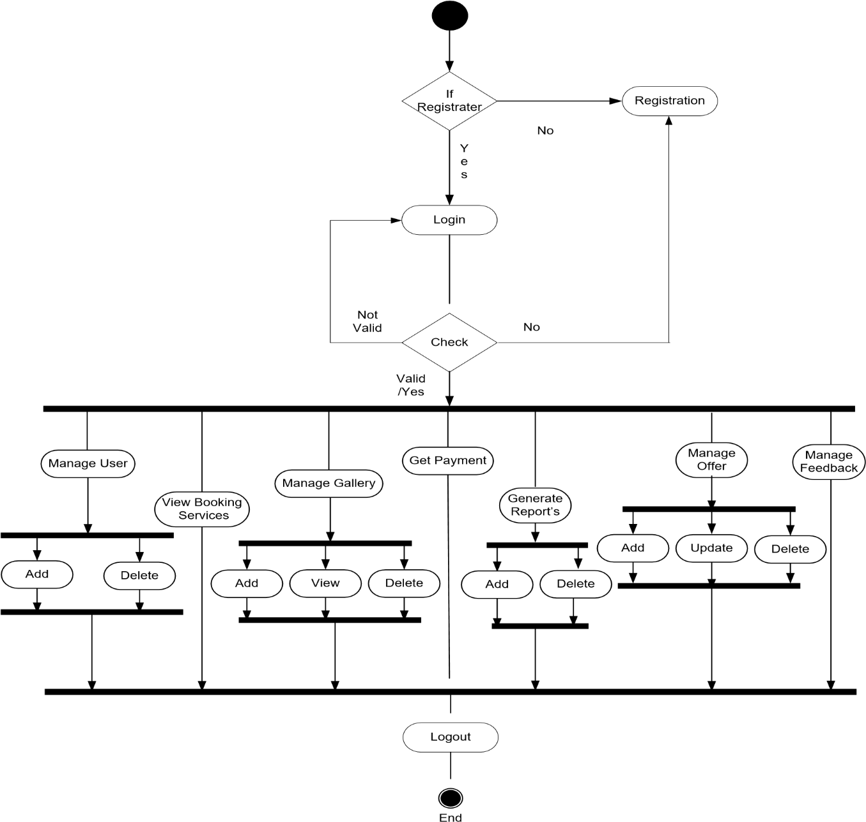
`
6.3 Activity Diagram:
Activity Diagram of Admin

Slide 12
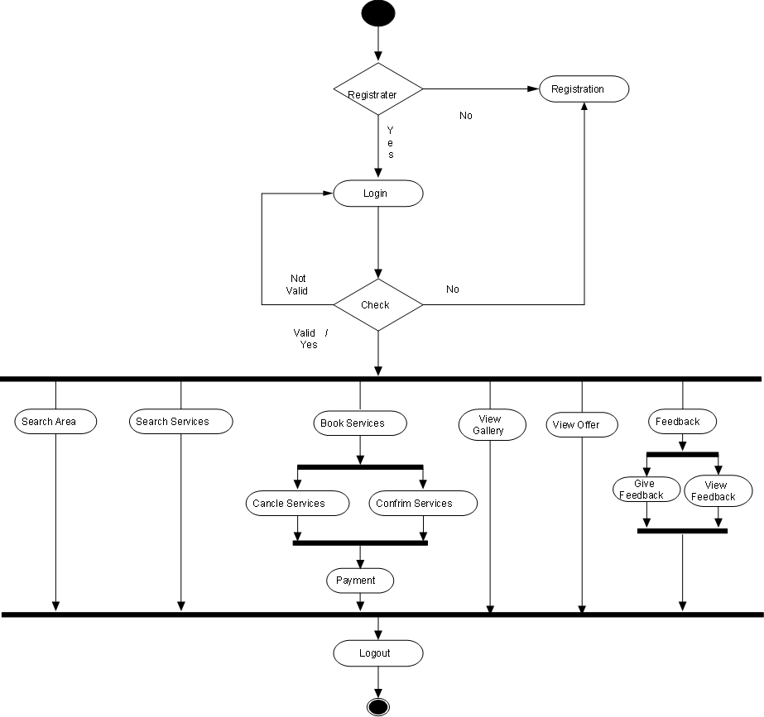
`
Activity Diagram of User
Page 110 of

Slide 13


`
Activity Diagram of Visitor
Search Services
View Services
View Gallery
Contactus
Page 111 of

Slide 14

`
6.4 Sequence Diagram & Class Diagram
Sequence Diagrams
Sequence Diagram of Login
Admin
User
System
Database
Login(Id /password)
Fetch
Details
Login
Verify
Login Succes
sfully/Unsuccess
Details
User(Id /
password)
Fetch
Details
Login Successfully/
Login
Details
Verify
Unsuccess

Slide 15
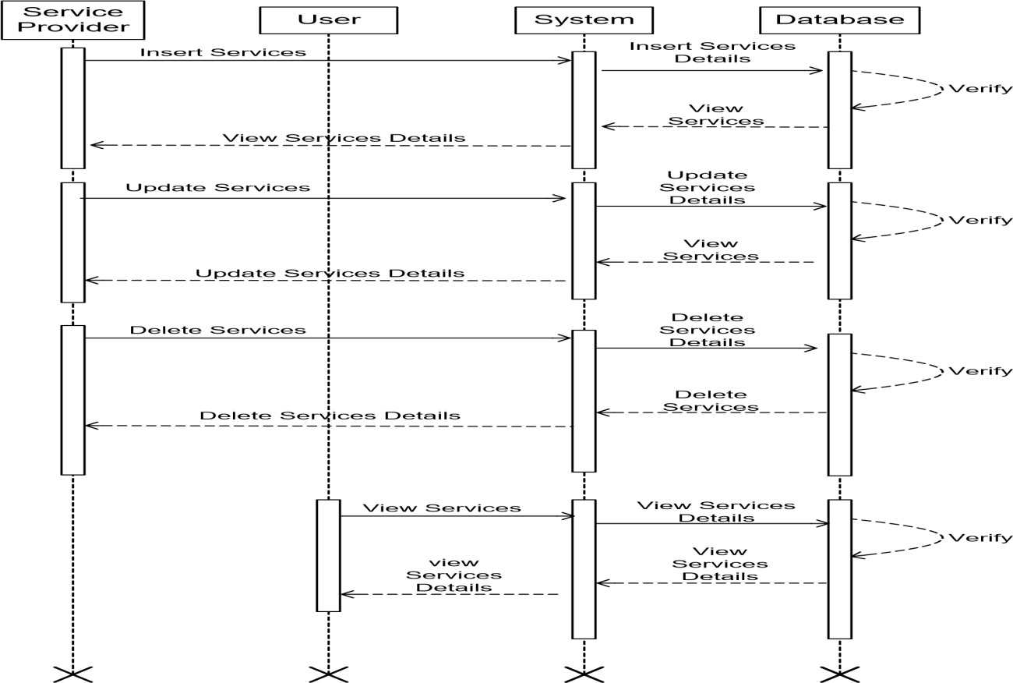
`
Sequence diagram of Manage Services

Slide 16
`
Sequence diagram of Book Services
Service Provider
User
System
Database
Search Services
Get Search Services
Details
Verify
Provide search Details
Provide search Details
Book Services
Book Services Details
Provide services Details
Provide services Details
Verify
Cancle Services
Cancle Services Details
Cancle Services
Cancle Services
Verify
Confirm Services
Confirm Services Details
Verify
Confirm Services
Confirm Services
Conform Services
Conform Services Details
Verify
Conform Services
Conform Services

Slide 17
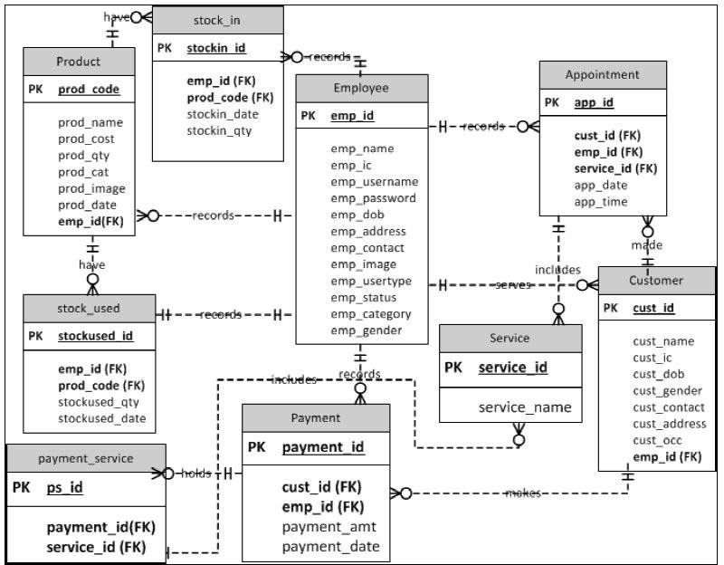
`
Class Diagram

Slide 18
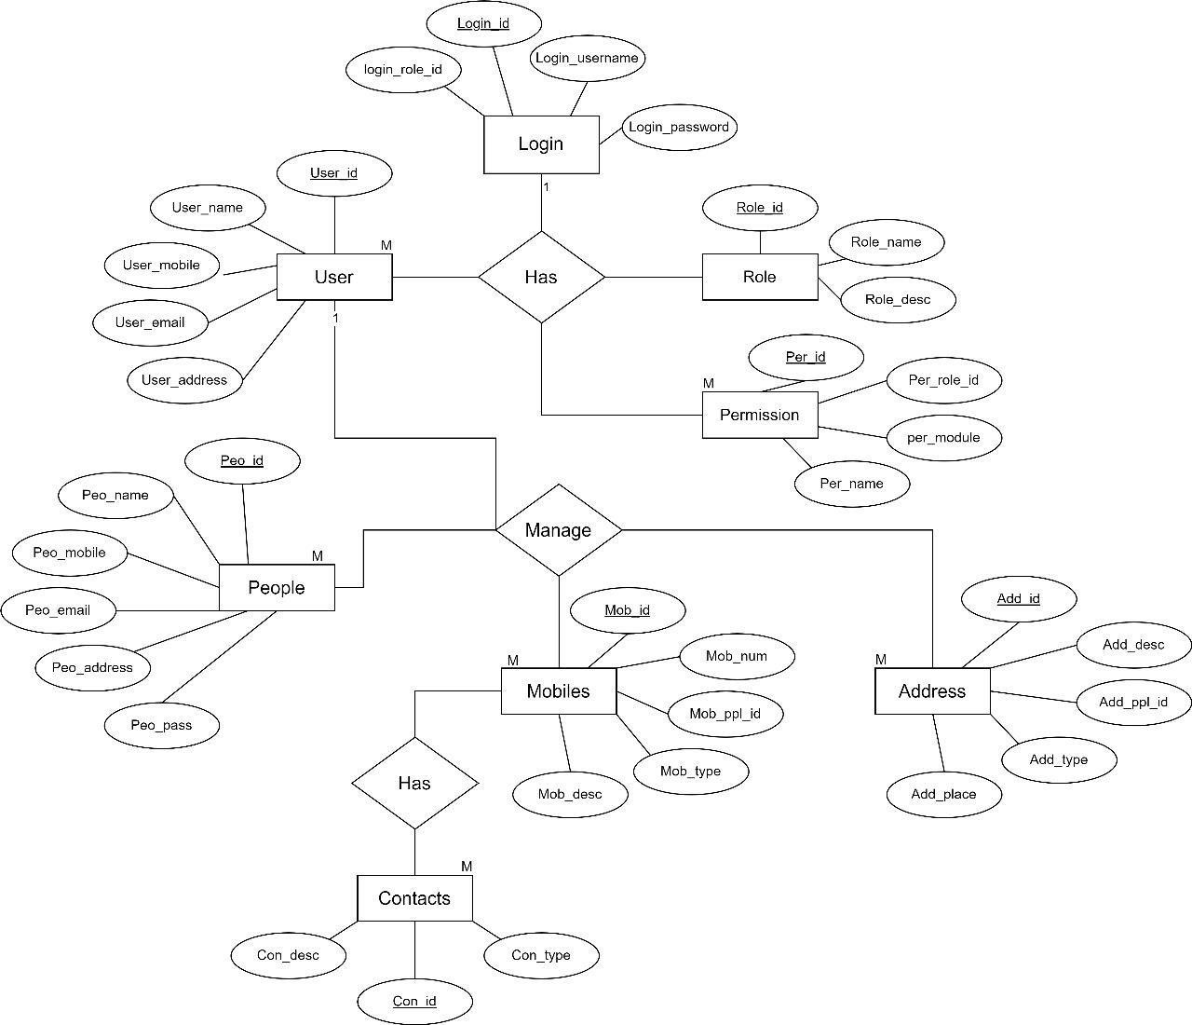
`
6.5 ER Diagram:

Slide 19
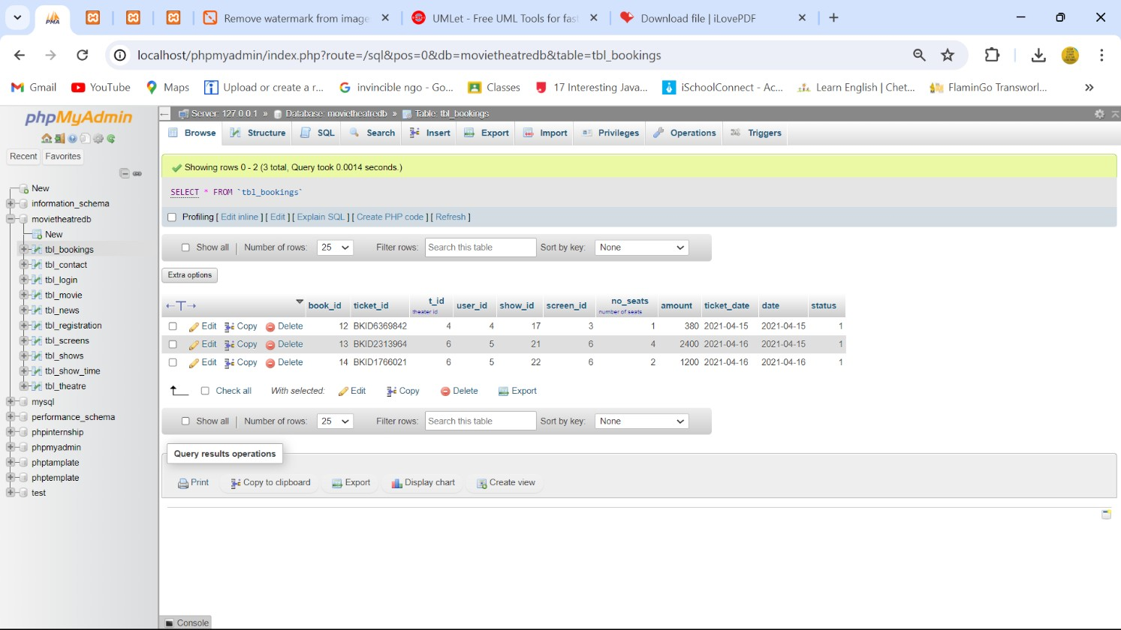
`
DATABASE SCREENSHOTS:

Slide 20
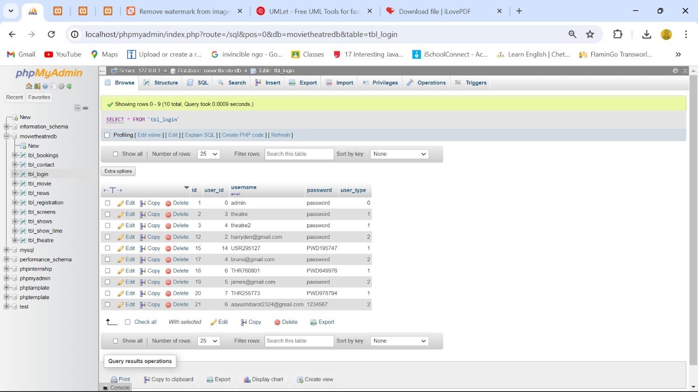
`

Slide 21
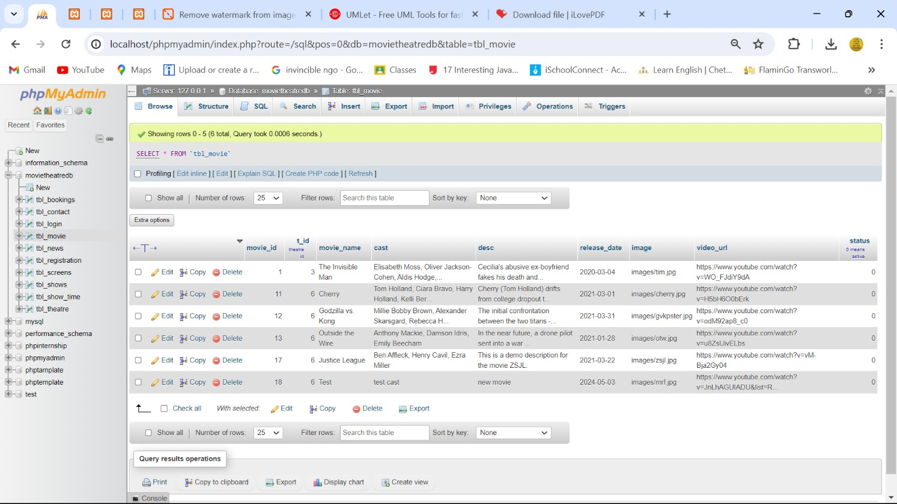
`

Slide 22
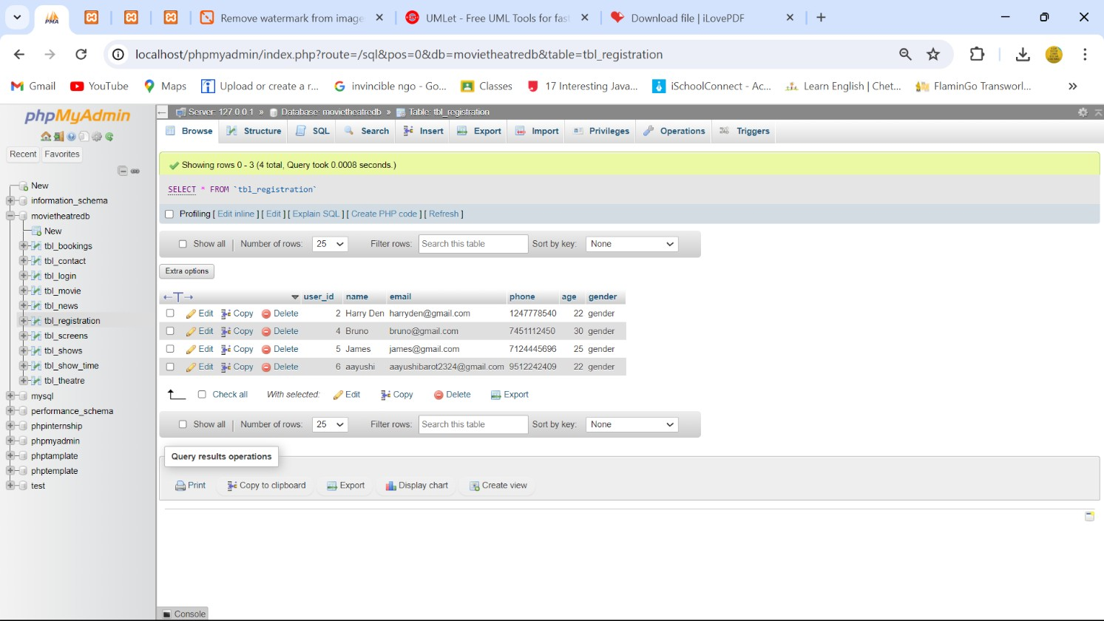
`

Slide 23
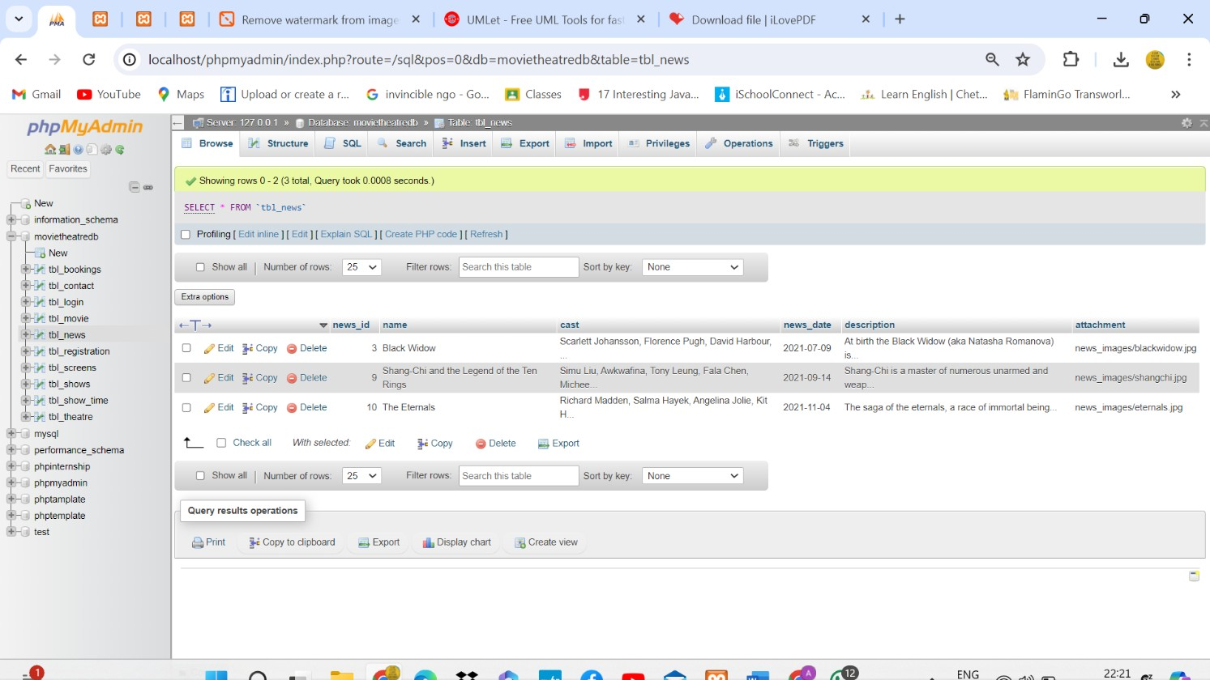
`

Slide 24
`
Page 210 of

Slide 25
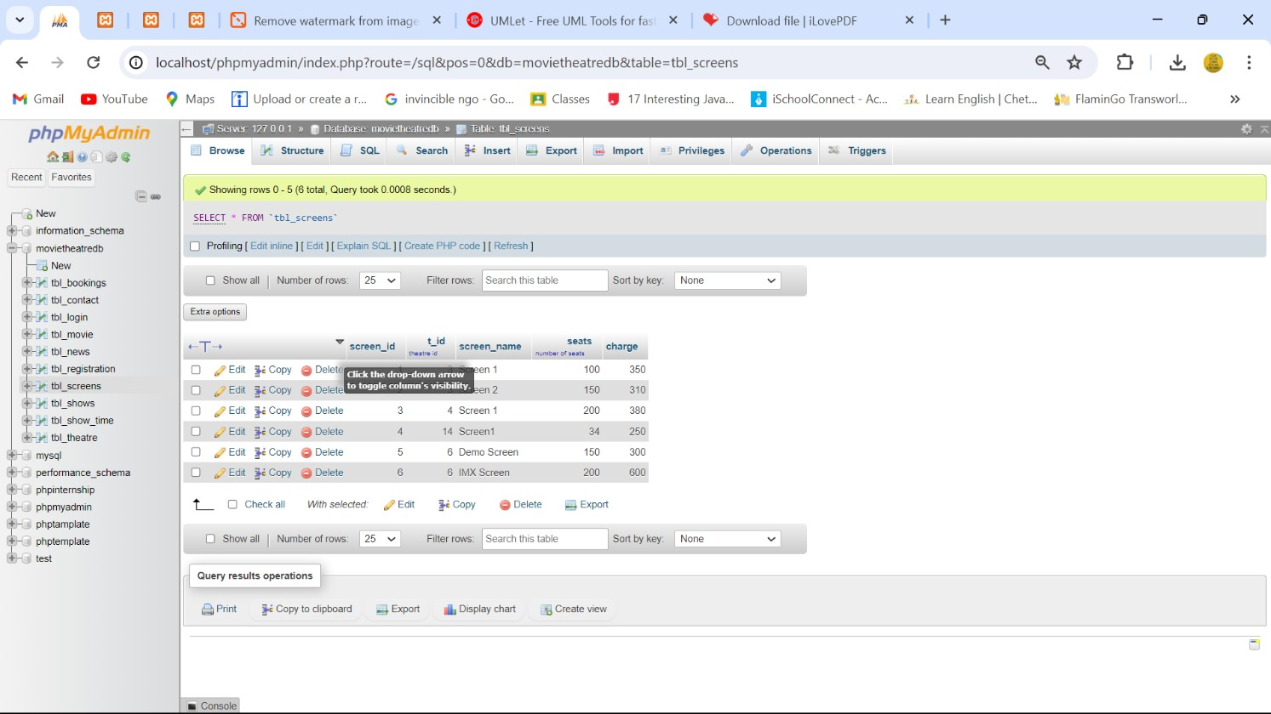
`
Page 211 of

Slide 26
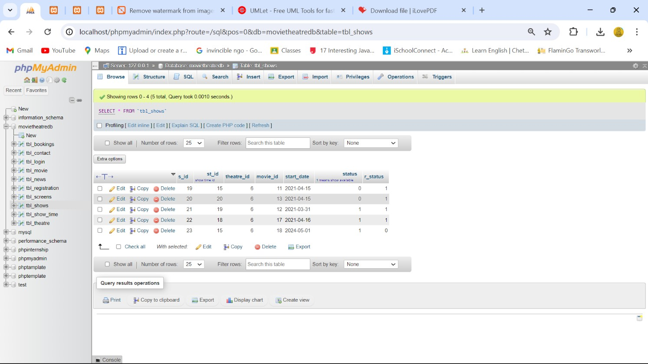
`
Day 6
Page 212 of

Slide 27
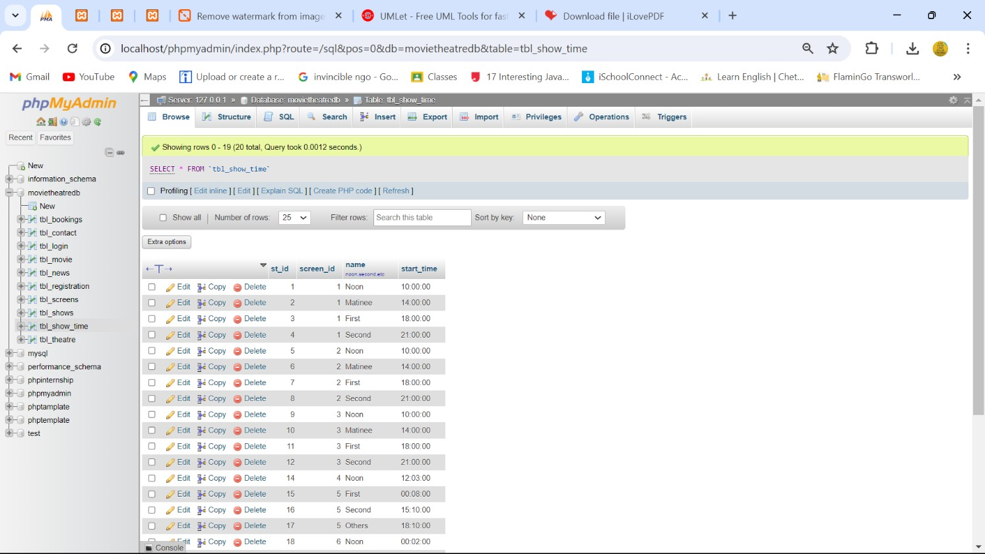
`

Slide 28
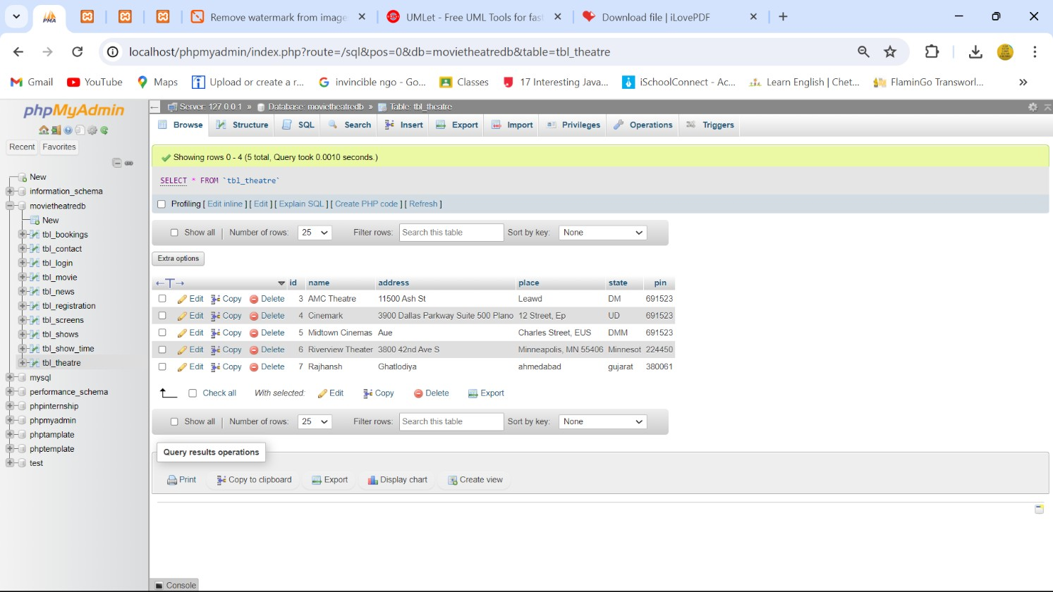
`

Slide 29
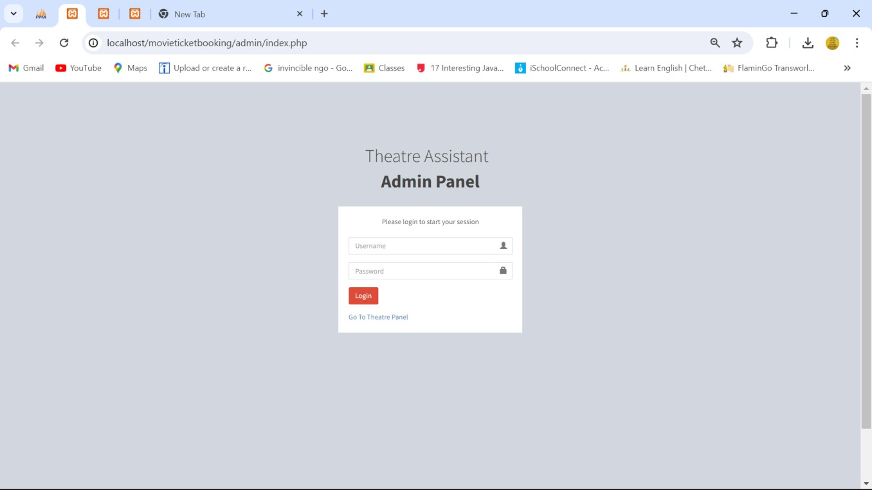
`
LOGIN PAGE FOR ADMINISTRATOR:

Slide 30
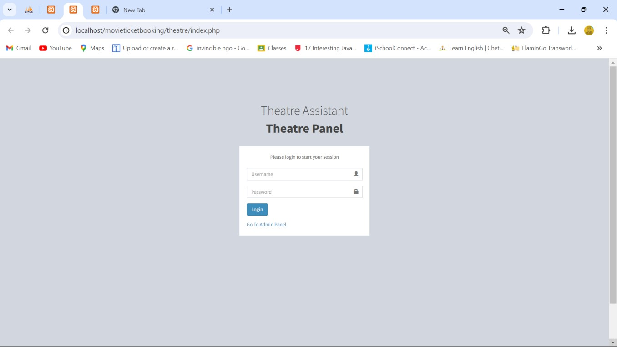
`
LOGIN PAGE FOR THEATRE PANEL:

Slide 31
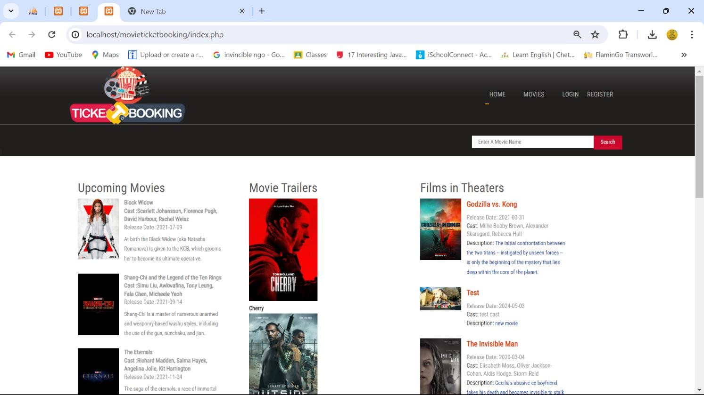
`

Slide 32
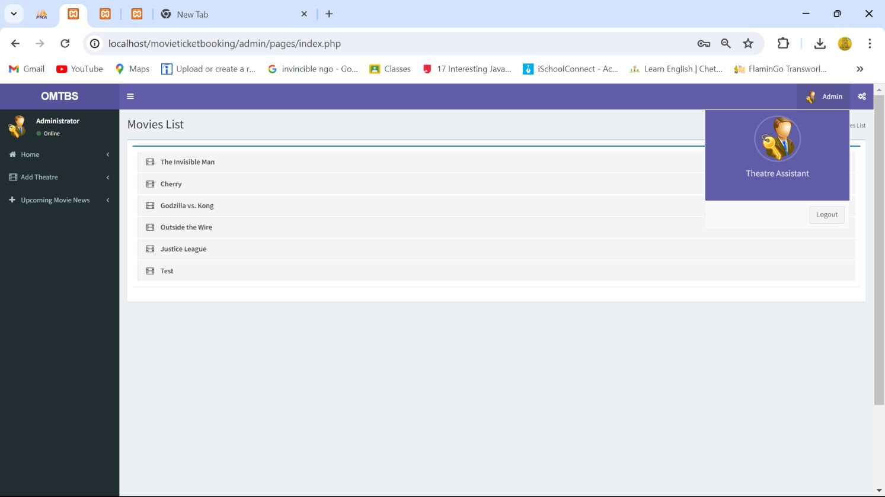
`

Slide 33
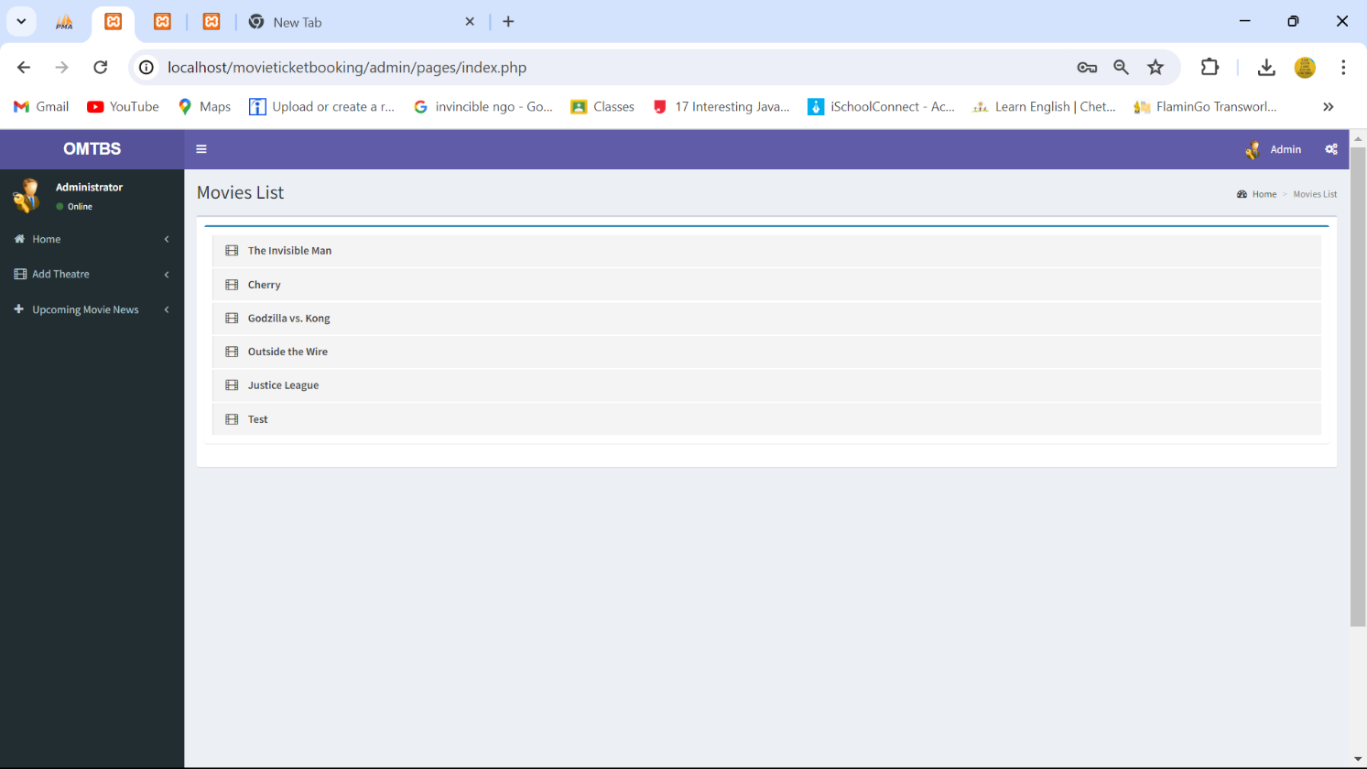
`

Slide 34
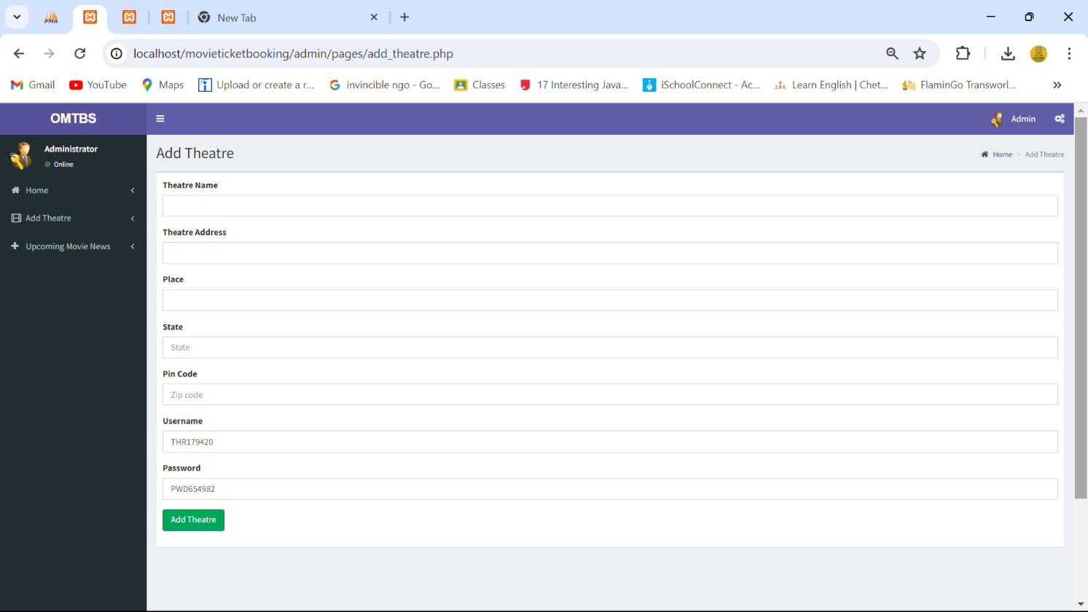
`

Slide 35
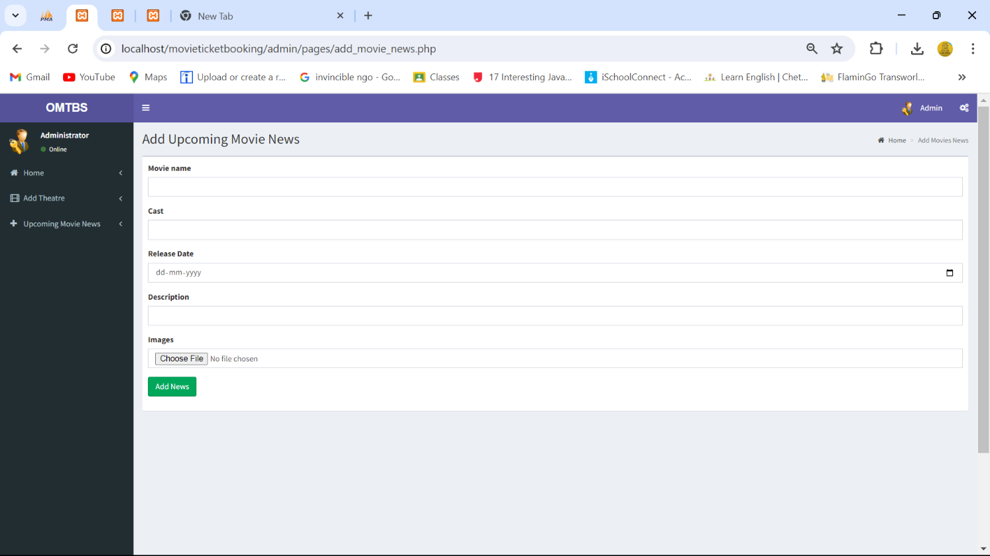
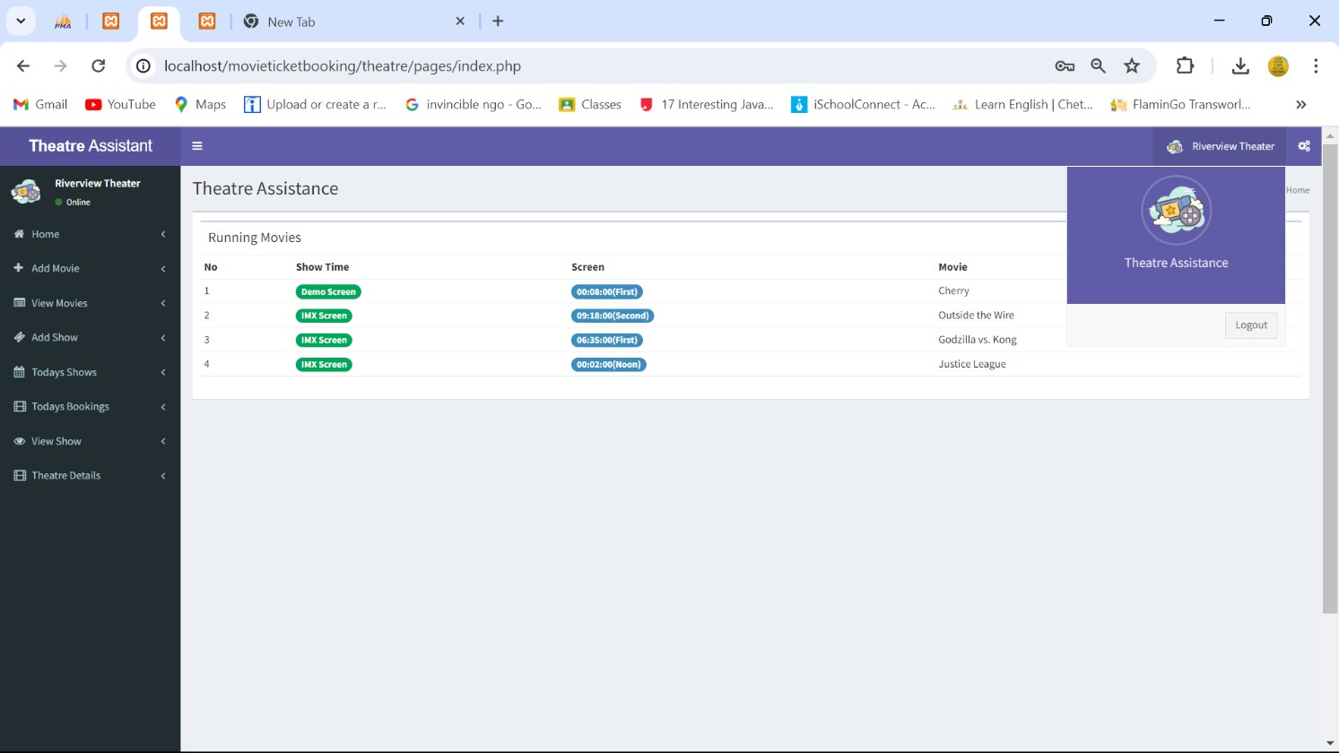
`

Slide 36
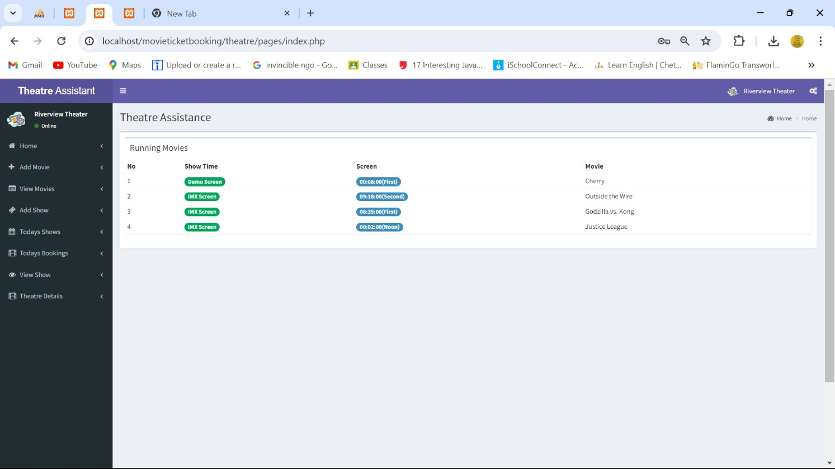
`

Slide 37

`

Slide 38
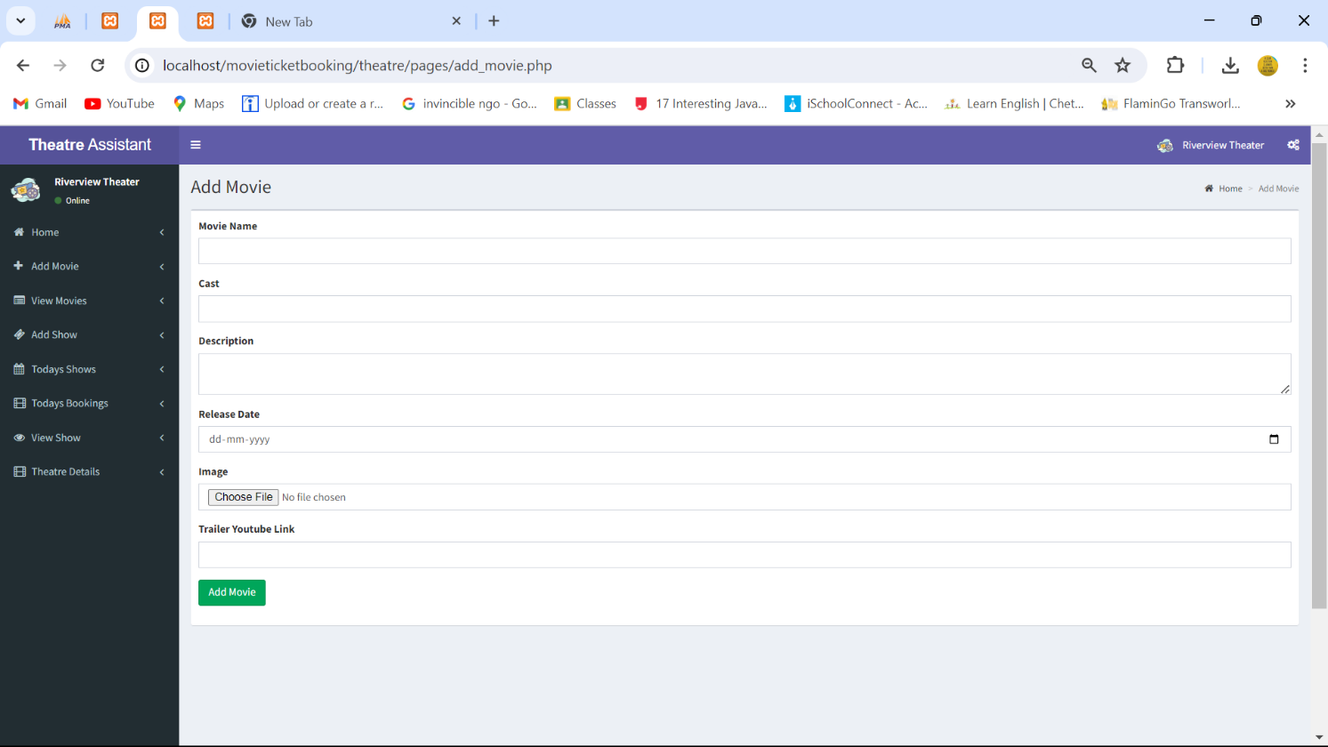
`

Slide 39
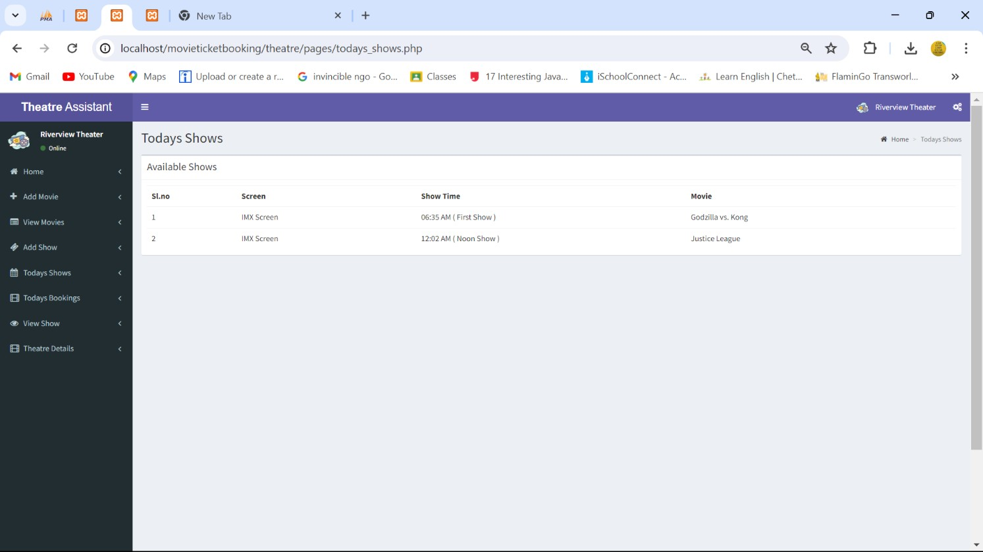
`

Slide 40

`

Slide 41
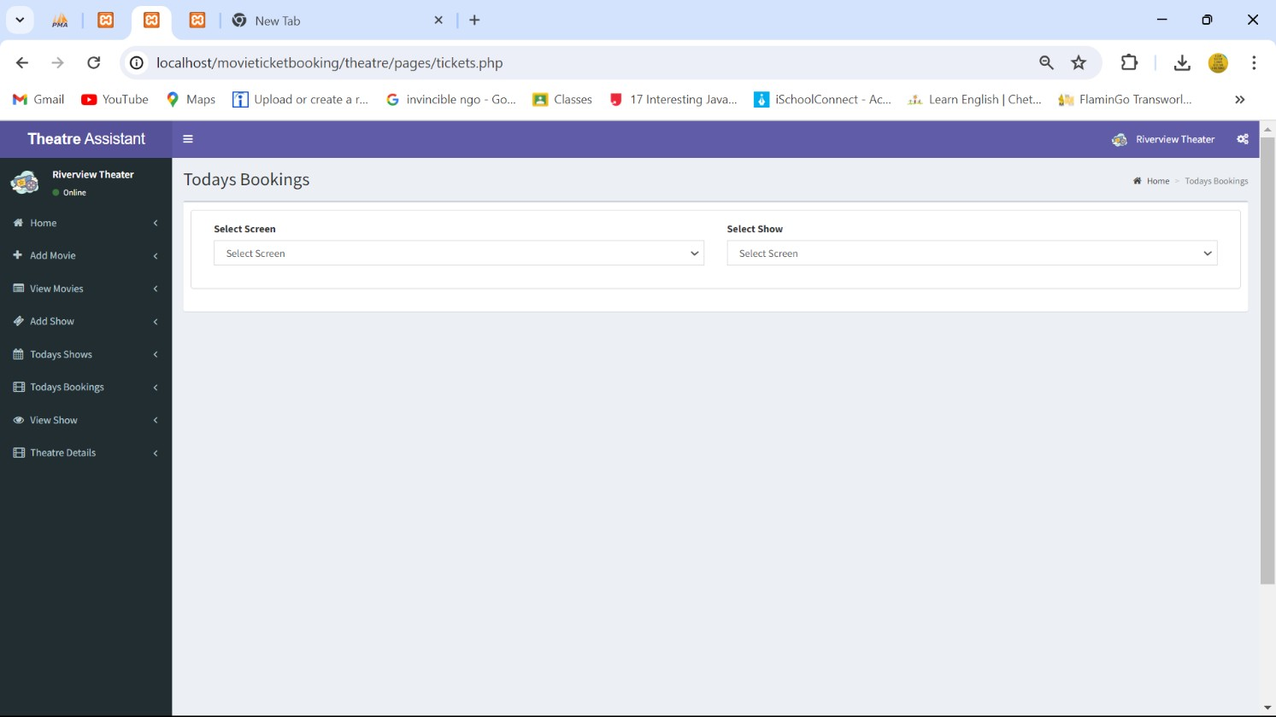
`

Slide 42
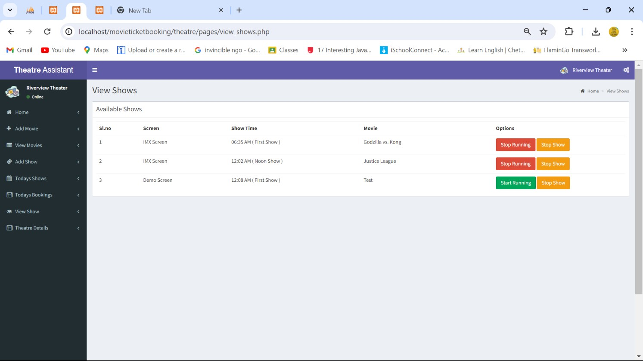
`

Slide 43
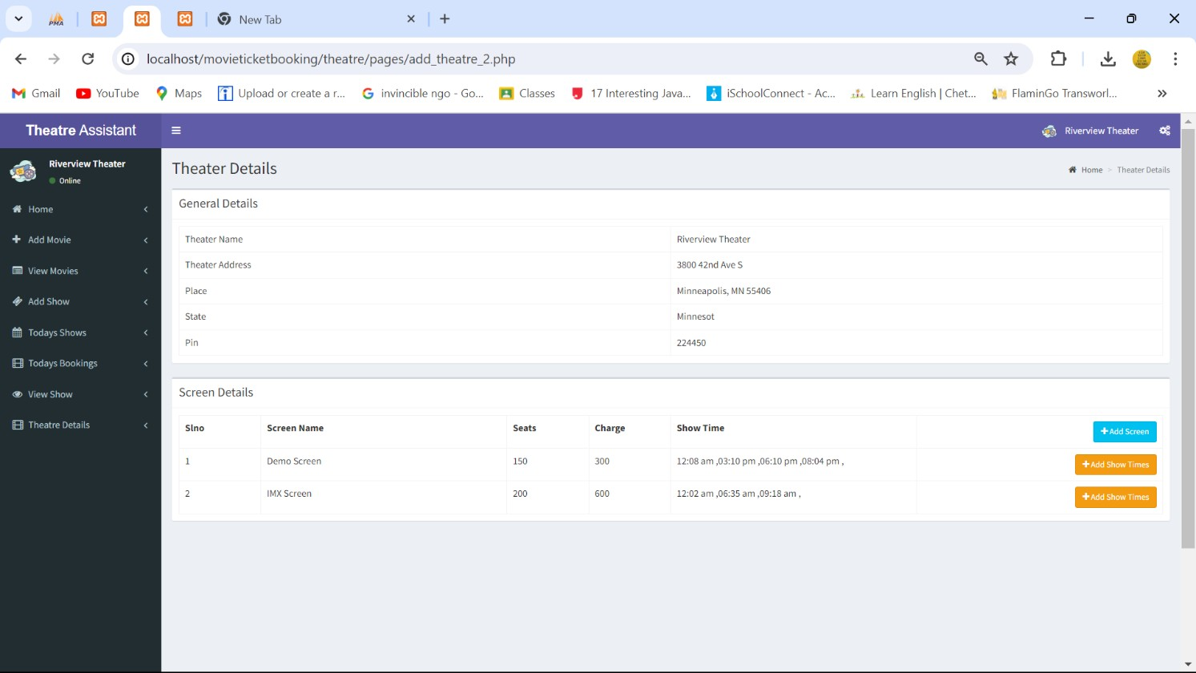
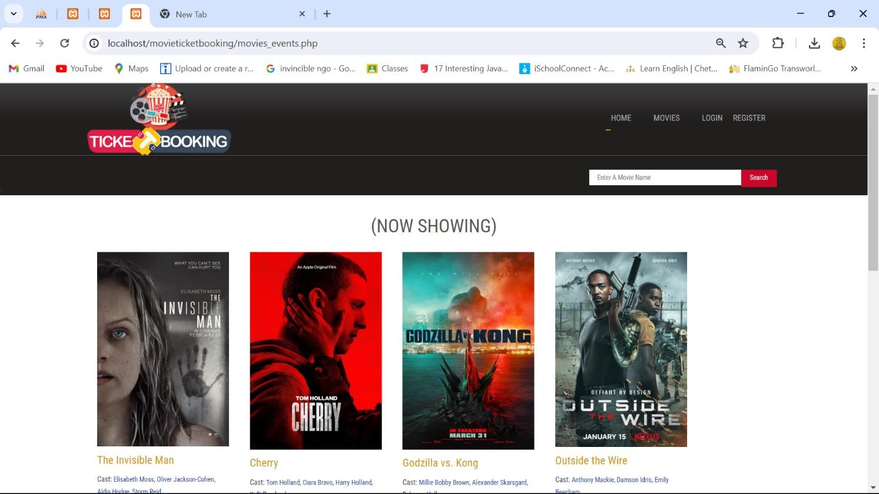
`

Slide 44
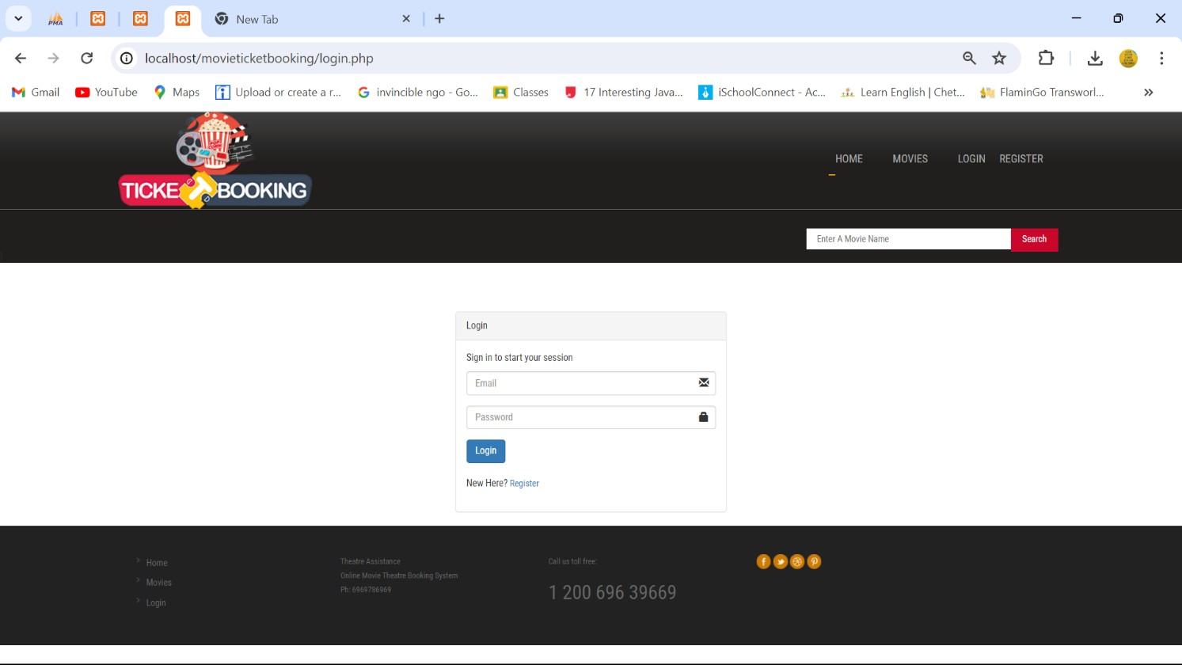
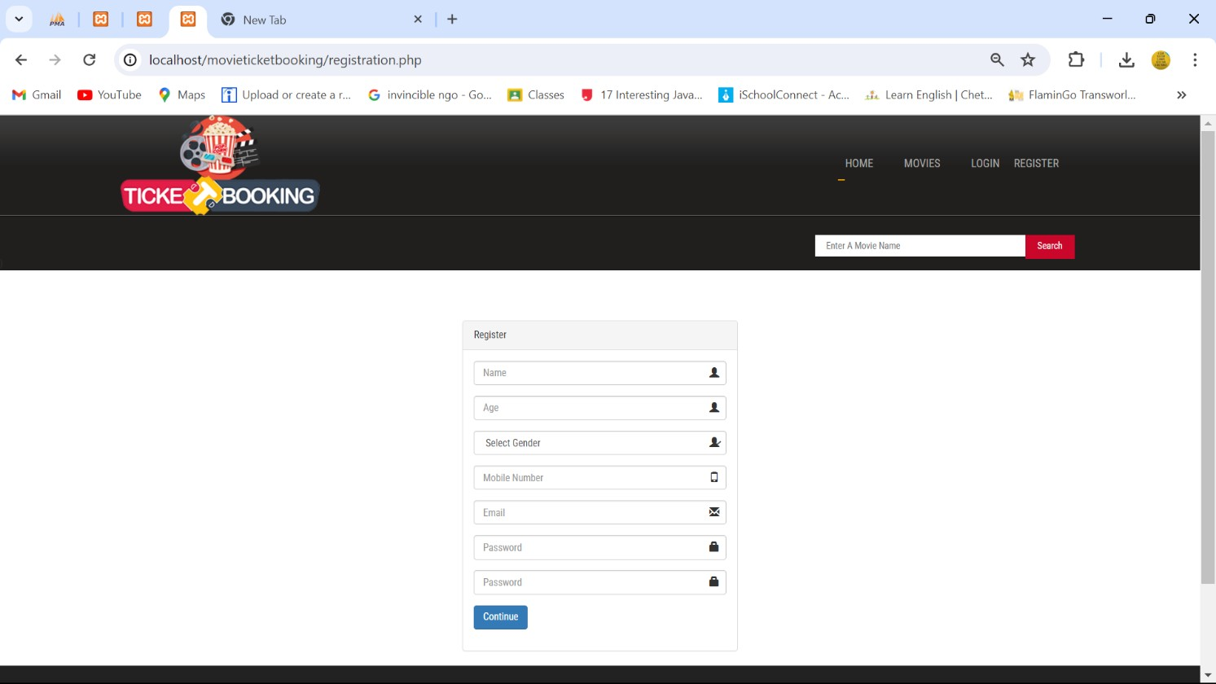
`

Slide 45
`
Application
If you’re looking for project ideas for a Content Management System (CMS) application, here are a few suggestions:
Blog Platform: Create a CMS for blogging, with features for user profiles, comments, and likes.
Event Management System: Develop a system to organize and promote events through a user-friendly interface.
Portfolio Website: Build a CMS that allows users to create and manage their own portfolio websites to showcase work and achievements.

Slide 46
`
10 Expected Outcomes:
For a CMS (Content Management System) project, the expected outcomes could include:
User-Friendly Interface: A CMS that is intuitive and easy to navigate for both administrators and end-users1.
Content Organization: Efficient categorization, tagging, and management of content to streamline the user experience1.
Customization and Flexibility: The ability to customize the look and functionality to meet specific user needs2.
Access Control: Robust user permissions and access control to ensure content security and integrity1.
Scalability: The system should be able to grow with the user’s needs, handling increased traffic and content without performance issues1.
SEO Optimization: Features that support search engine optimization to increase visibility and traffic2.
Analytics and Reporting: Tools to track user engagement and content performance to inform strategy1.
Multi-Platform Support: Compatibility with various devices and browsers for a consistent experience across platforms2.
These outcomes focus on delivering a CMS that not only manages content effectively but also enhances the overall digital experience for its users.
Page 410 of

Slide 47
`
11 Future Scope
The future scope for Content Management Systems (CMS) is quite promising and includes several key trends:
Omnichannel Experience: CMSs are evolving to provide a seamless content experience across multiple platforms and devices1.
Headless and Hybrid CMS: There’s a shift towards headless CMS, where the content repository is separated from the presentation layer, allowing for greater flexibility in content delivery2.
Content-First Approach: The focus is on creating content that can be easily accessed and used in different contexts, prioritizing the content over the design1.
AI and Machine Learning: Integration of AI to automate content personalization, improve search functionality, and enhance user experiences3.
Increased Demand for Digital Marketing Solutions: As digital marketing grows, so does the need for CMSs that can support complex marketing strategies3.
Growth in Digital Retail: E-commerce integration is becoming more prevalent in CMSs to support the growing digital retail sector3.
Enhanced Security: With the rise of cyber threats, CMSs will continue to develop stronger security measures to protect content and user data2.
These trends indicate that CMSs will continue to become more sophisticated, userfriendly, and integral to digital strategies in various industries.

Slide 48
`
12. References
BootstrapMade Impact Template:
https://bootstrapmade.com/impact-bootstrap-business-website-template/
BootstrapMade Impact Template:
https://bootstrapmade.com/nice-admin-bootstrap-admin-html-template/

